Slide 1
CS584 Machine Learning
Lecture 18. Dimensionality Reduction and Unsupervised Learning
Oleksandr Narykov
onarykov@iit.edu

Slide 2

Class Project
Team effort, 3-5 people. Teams of one are possible, but prior discussion is needed
Recommended data source – Kaggle
Consider necessary compute time!
Timeline:
Oct 10 – teams are formed, dataset selected and registration spreadsheet filled
Nov 12,14 – Interim project review. Short 3-min presentation about your progress
Nov 30 – Final report is due. Approximately 5 pages + code in a publicly accessible git repository. Link should be included in the report document
39

Slide 3
Class Project Requirements
Explore dataset – correlation between features, their impact on target, independence assumptions
Try multiple visualization strategies: correlation plots, dimensionality reduction approaches – PCA, UMAP, t-SNE. Explain gained insights
Explore data using unsupervised learning techniques
Identify appropriate cross-validation strategy
Train a simple model first. Use validation set for hyperparameter tuning and/or early stopping. Analyze its performance using cross-validation. Identify potential pitfalls.
Propose ways to improve performance – e.g., feature selection, regularization, increasing model complexity. Conduct at least 2 more experiments
39

Slide 4
Dimensionality Reduction

Slide 5
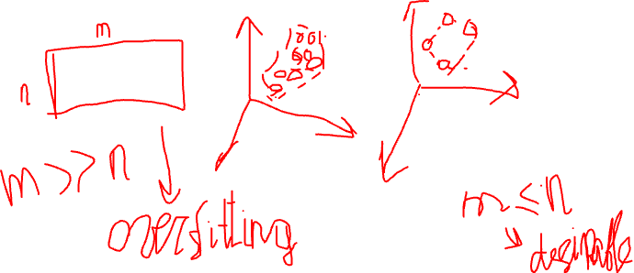
Motivation
Remove useless features
Learn a low dimensional representation
Visualization
2

Slide 6
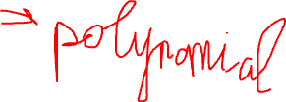
Approaches
Feature selection
Feature extraction
3

Slide 7
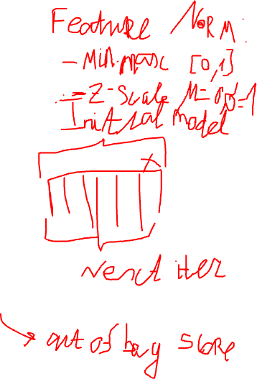
Feature Selection
Select a subset of the features
Several approaches
Univariate feature selection
Mutual information, Chi2
Recursive feature elimination
Using an external estimator, recursively remove the least useful features
Sequential feature selection
Model-based feature selection
L1 regularization, Random Forest, Boosting, Variance Inflation Factor
Sequential feature selection
Can use any model and performance metric
4

Slide 8

Feature Extraction
Feature extraction, projection, latent
representation learning, manifold learning, …
Given an input, project it into another dimension
(often lower)
Unsupervised
Principal component analysis, UMAP, isomap, t-SNE, deep
learning, …
Supervised
Linear discriminant analysis, deep learning, …
5

Slide 9
Feature Extraction
Projection, latent representation learning, manifold learning, …
Given an input, project it into another dimension
(often lower)
Feature engineering
Unsupervised
Principal component analysis, UMAP, isomap, t-SNE, deep
learning, …
Supervised
Linear discriminant analysis, deep learning, …
5

Slide 10
We’ll Cover
Principal component analysis
Autoencoder
6

Slide 11
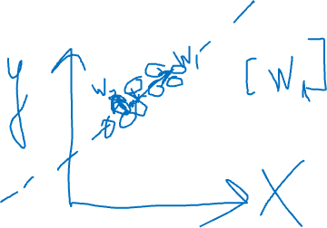
Principal Component Analysis
Given a dataset 𝒙 with 𝑑 dimensions, project it into 𝑘 dimensions (𝑘 < 𝑑) with minimum loss of information
𝒛 = 𝒘^{𝑇}𝒙
Principal component analysis (PCA) maximizes the variance in the projected space so that objects are spread out
𝑎𝑟𝑔𝑚𝑎𝑥_{𝒘}𝑉𝑎𝑟(𝒛)
7

Slide 12
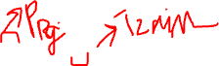
PCA Objective
𝒛 = 𝒘^{𝑇}𝒙
𝑎𝑟𝑔𝑚𝑎𝑥_{𝒘}𝑉𝑎𝑟(𝒛)
Reminder: 𝑉𝑎𝑟 𝑎𝑋 + 𝑏
𝑉𝑎𝑟 𝒛 = 𝒘^{𝑇}𝑉𝑎𝑟(𝒙)𝒘
= 𝑎²𝑉𝑎𝑟(𝑋)
We can trivially maximize variance by multiplying w by a large constant; hence, we enforce that 𝒘 is unit length
𝒘𝒘^{𝑇} = 1
Objective
maximize 𝒘^{𝑇}𝑉𝑎𝑟(𝒙)𝒘 subject to 𝒘𝒘^{𝑇} = 1
8

Slide 13
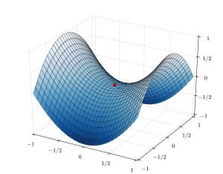

Background – Constrained optimization
Find θ
maximizing f (θ) subject to
c₁ (θ) = 0
...
c_{m} (θ) = 0
Form the Lagrangian:
𝒘𝒘^{𝑇} = 1
F (θ, λ) = f (θ) − ∑λ_{j}c_{j} (θ)
j =1
m
9

Slide 14
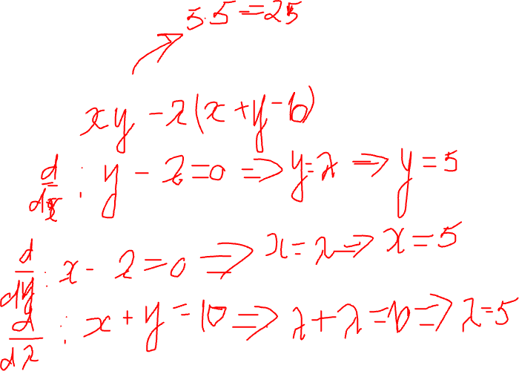
Example
Maximize 𝑥𝑦 subject to 𝑥 + 𝑦 = 10
Notes:
xy – lam (x+y-10)
d/dx
d/dy
d/dlam

Slide 15
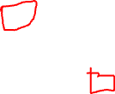
PCA with One Dimension
maximize 𝑉𝑎𝑟 𝑧₁ = 𝑤^{𝑇}𝑉𝑎𝑟 𝒙 𝑤₁ subject to 𝑤^{𝑇}𝑤₁ = 1
1 1
Let the variance of 𝒙 be the covariance matrix Σ
Objective
Maximize 𝑤^{𝑇}Σ𝑤₁ subject to 𝑤^{𝑇}𝑤₁ = 1
1 1
Lagrange
maximize 𝑤^{𝑇}Σ𝑤₁ − 𝜆(𝑤^{𝑇}𝑤₁ − 1)
1 1
Take derivative with respect to 𝑤₁, set to zero
2Σ𝑤₁ − 2𝜆𝑤₁ = 0
Σ𝑤₁ = 𝜆𝑤₁
𝑤₁ is an eigenvector and 𝜆 is an eigenvalue of Σ
Because we maximize variance
maximize 𝑤^{𝑇}Σ𝑤₁ = 𝑤^{𝑇}𝜆𝑤₁ = 𝜆𝑤^{𝑇}𝑤₁ = 𝜆
1 1 1
𝑤₁is the eigenvector that corresponds to the largest eigenvalue of Σ
11

Slide 16
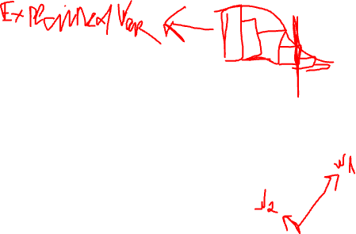
PCA with 𝑘 Dimensions
We want the second vector 𝑤₂ to be orthogonal to
𝑤₁ so that the 𝑧₂ is uncorrelated with 𝑧₁
Skipping the derivation details
𝑤₁ is the eigenvector for the largest eigenvalue 𝜆₁
𝑤₂ is the eigenvector for the second largest eigenvalue 𝜆₂
…
𝑤_{𝑘} is the eigenvector for the 𝑘^{𝑡ℎ} largest eigenvalue 𝜆_{𝑘}
In the end, the transformation is typically
centered around zero (in the new dimensions)
𝒛 = 𝐰^{T}(𝐱 − 𝐦) where 𝒎 is the mean of 𝒙
12

Slide 17
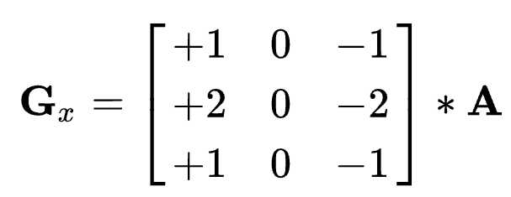
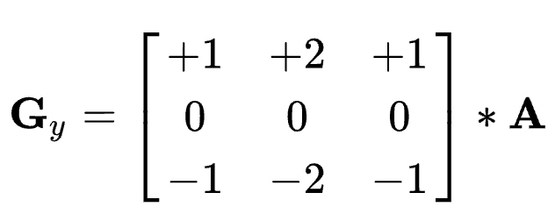
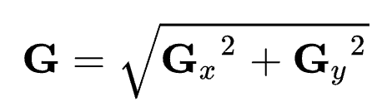
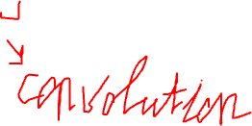
Feature Engineering
Using domain knowledge to transform data
Sobel operator in Computer Vision
5

Slide 18
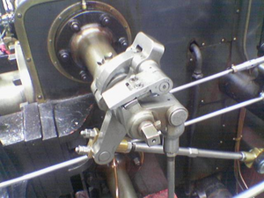
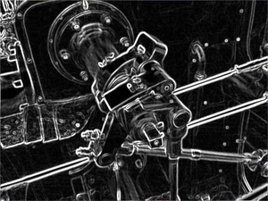
Feature Engineering
Using domain knowledge to transform data
Sobel operator in Computer Vision
5

Slide 19
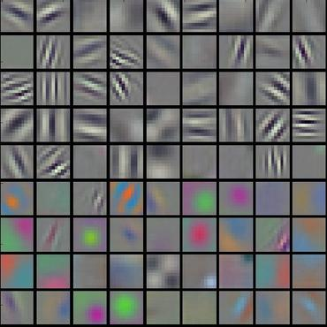
Convolution Network
End-to-end learning
Deep learning is representation learning
Weight matrices of hidden layers of convolution network

Slide 20
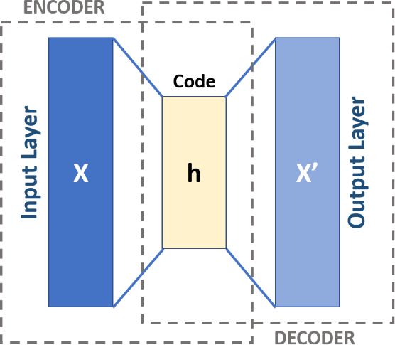
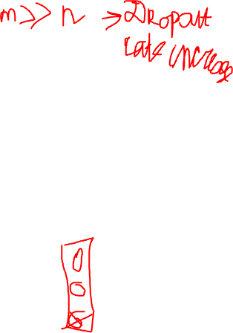
AutoEncoder
A neural network architecture where the input and output are the same
𝒙 → 𝒉 → 𝒙
Input x is encoded into h, where h is typically lower dimensional than x and h is decoded back to x, with some error
14
https://upload.wikimedia.org/wikipedia/commons/3/37/Autoencoder_schema.png

Slide 21
Other DL Methods
Transformers
Contrastive learning
…
International conference on learning representations (ICLR)
https://iclr.cc/
15

Slide 22
Unsupervised Learning

Slide 23
Motivation
There is no supervision – i.e., there is no target variable
Find groups / clusters in the data
2

Slide 24
Various Approaches
K-Means
Expectation Maximization (EM)
EM is a general approach that can be used for many
other tasks, one of which is clustering
Hierarchical clustering
DBScan
Spectral clustering
Mean-shift
… and many more
3

Slide 25
We’ll Cover
K-Means
EM for mixture of Gaussians
4

Slide 26
K-Means
Basic idea: given data, find k prototype vectors, and assign each data point to its closest prototype vector, such that the sum of the distances to the closest prototype vectors is minimized
𝑁
𝑗=1
Let 𝐷 = 𝑥
𝑘
𝑖=1
be the data and let 𝑚
be the
𝑗
𝑖
prototype vectors. Objective:
minimize ∑^{𝑁} min 𝑑𝑖𝑠𝑡𝑎𝑛𝑐𝑒 𝑥_{𝑗}, 𝑚_{𝑖}
𝑗=1
𝑖
A typical distance metric is Euclidan distance
5

Slide 27
K-Means
Initialize k centers 𝑚_{𝑖}
𝑘
𝑖=1
Repeat until convergence
Assign each data point 𝑥_{𝑗} to the closest cluster center
Re-compute each center 𝑚_{𝑖}
𝑘
𝑖=1
as the mean of the
points that are assigned to that center
6

Slide 28
EM for Mixture of Gaussians
Basic idea: very much like the Bayes classifier where we have P(C) and p(x|C) and we use that for computing P(C|x), except, in this case, classes are not given to us. So, we take an iterative approach
Repeat until convergence
Assign data points to classes/centers/components, probabilistically (i.e., compute P(C|x) using P(C) and p(x|C) ) – Expectation
Re-estimate class/center/component parameters based on the probabilistic assignments to classes/centers (i.e., recompute P(C) and p(x|C) using the probabilistic assignments) – Maximization
7

Slide 29
Notation
𝑃 𝐶_{𝑖} : prior probability of component 𝐶_{𝑖}
A multinomial distribution
𝑃 𝑥_{𝑗} 𝐶_{𝑖} : probability that component 𝐶_{𝑖} generated 𝑥_{𝑗}
A Gaussian distribution with mean 𝜇_{𝑖} and variance 𝜎²
𝑖
This can be easily generalized to multivariate Gaussian distribution with mean 𝜇_{𝑖} and co-variance Σ_{𝑖}
𝑃 𝐶_{𝑖} 𝑥_{𝑗} : probability that 𝑥_{𝑗} belongs to component 𝐶_{𝑖}
Via Bayes rule, 𝑃 𝐶_{𝑖} 𝑥_{𝑗} ∝ 𝑃 𝑥_{𝑗} 𝐶_{𝑖} 𝑃 𝐶_{𝑖}
𝑛_{𝑖}: Expected number of instances that belong to component 𝐶_{𝑖}
𝑛_{𝑖} = ∑^{𝑁} 𝑃 𝐶_{𝑖} 𝑥_{𝑗}
𝑗=1
8

Slide 30
EM
E step: compute cluster/component assignments
𝑃 𝐶_{𝑖} 𝑥_{𝑗} ∝ 𝑃 𝑥_{𝑗} 𝐶_{𝑖} 𝑃 𝐶_{𝑖}
M step: recompute parameters
𝑛_{𝑖} = ∑^{𝑁} 𝑃 𝐶_{𝑖} 𝑥_{𝑗}
𝑗=1
Weighted counts, where weights are 𝑃 𝐶_{𝑖} 𝑥_{𝑗}
𝑃 𝐶
₌ 𝑛_{𝑖}
𝑖
𝑁
𝑃 𝑥_{𝑗} 𝐶_{𝑖} ∼ Ν 𝜇_{𝑖}, 𝜎²
𝑖
∑𝑁
𝑃 𝐶 𝑥 𝑥_{𝑗}
𝜇_{𝑖} =
𝑗=1
𝑖 𝑗
𝑛
𝑖
Weighted mean, where weights are 𝑃 𝐶_{𝑖} 𝑥_{𝑗}
2
∑𝑁
𝑃 𝐶 𝑥 𝑥 −𝑚
𝑗=1
𝑖 𝑗
𝑗 𝑖
𝜎 ² =
𝑖
𝑛_{𝑖}
9
Weighted variance, where weights are 𝑃 𝐶_{𝑖} 𝑥_{𝑗}

Slide 31
EM
E step: compute cluster/component assignments
𝑃 𝐶_{𝑖} 𝑥_{𝑗} ∝ 𝑃 𝑥_{𝑗} 𝐶_{𝑖} 𝑃 𝐶_{𝑖}
M step: recompute parameters
𝑛_{𝑖} = ∑^{𝑁} 𝑃 𝐶_{𝑖} 𝑥_{𝑗}
𝑗=1
Weighted counts, where weights are 𝑃 𝐶_{𝑖} 𝑥_{𝑗}
𝑃 𝐶
₌ 𝑛_{𝑖}
𝑖
𝑁
𝑃 𝑥_{𝑗} 𝐶_{𝑖} ∼ Ν 𝜇_{𝑖}, 𝜎²
𝑖
∑𝑁
𝑃 𝐶 𝑥 𝑥_{𝑗}
𝜇_{𝑖} =
𝑗=1
𝑖 𝑗
𝑛
𝑖
Weighted mean, where weights are 𝑃 𝐶_{𝑖} 𝑥_{𝑗}
2
∑𝑁
𝑃 𝐶 𝑥 𝑥 −𝑚
𝑗=1
𝑖 𝑗
𝑗 𝑖
𝜎 ² =
𝑖
𝑛_{𝑖}
9
Weighted variance, where weights are 𝑃 𝐶_{𝑖} 𝑥_{𝑗}

Slide 32
EM
https://upload.wikimedia.org/wikipedia/commons/6/69/EM_Clustering_of_Old_Faithful_data.gif
9

Slide 33
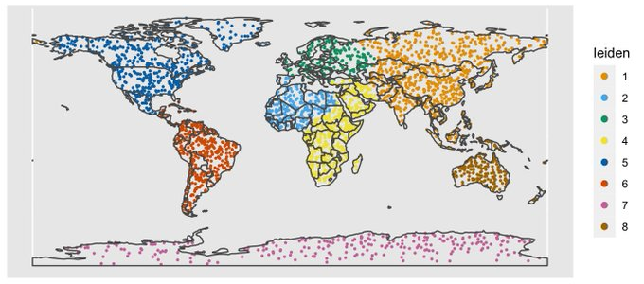
Leiden Clustering Example
https://github.com/lambdamoses/umap_globe
12

Slide 34
UMAP + Leiden Clustering Example
12
https://github.com/lambdamoses/umap_globe

Slide 35
Scikit-Learn
http://scikit- learn.org/stable/modules/clustering.html
10

